Slide 1
Maximum Spherical Mean Value (mSMV) for Shadow Reduction
Alexandra Roberts
04/02/2022

Slide 2
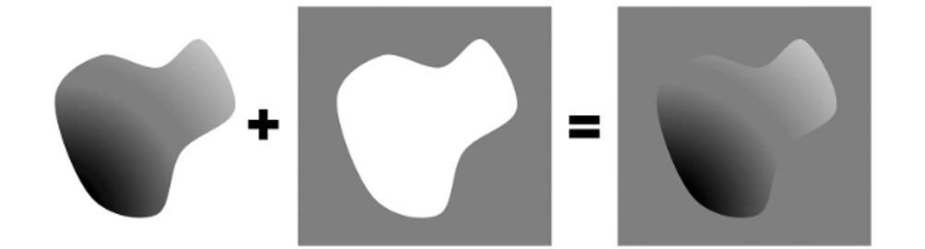
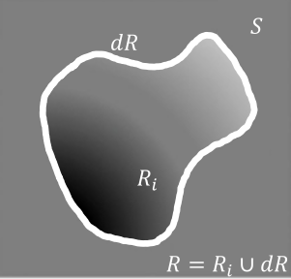



Green’s theorem (Fig. 1)
$$∂R$$
$$R_{i}$$
$$R=R_{i}∪∂R$$

Slide 3
Maximum corollary of Green’s theorem (Fig. 2)

Slide 4
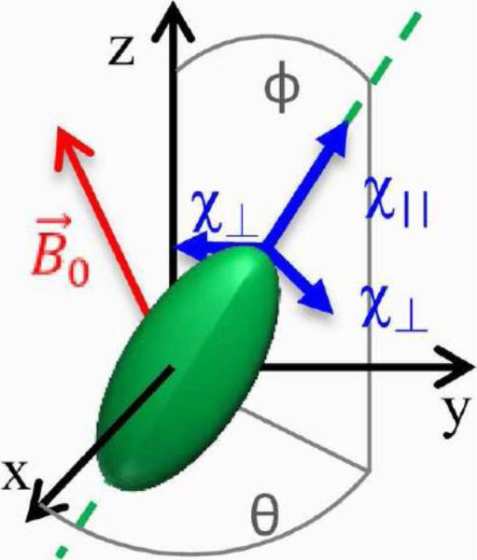
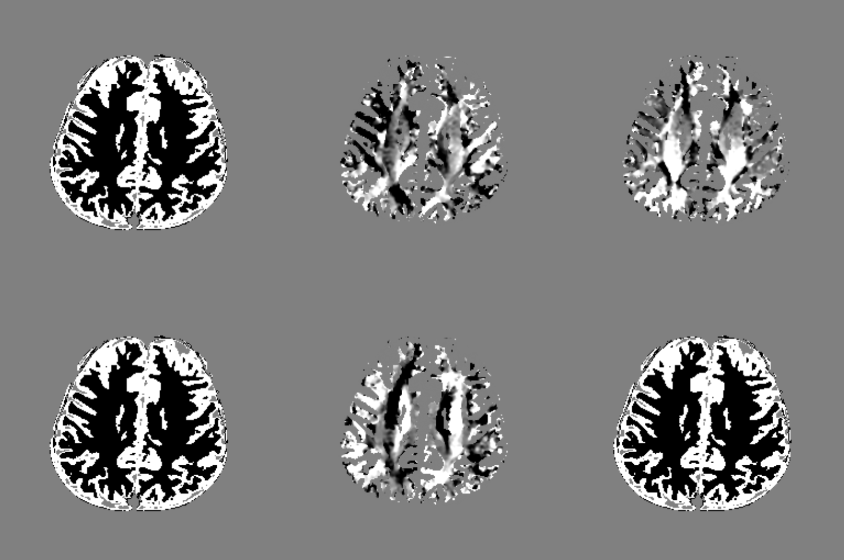
Numerical brain

Slide 5
Axial numerical brain
Ground truth
Control
SMV
SHARP
RESHARP
VSHARP
LBV
iSMV
mSMV
Ground truth
Control
SMV
SHARP
RESHARP
VSHARP
LBV
iSMV
mSMV

Slide 6
Sagittal and coronal numerical brain
Ground truth
Control
SMV
SHARP
RESHARP
VSHARP
LBV
iSMV
mSMV
Ground truth
Control
SMV
SHARP
RESHARP
VSHARP
LBV
iSMV
mSMV

Slide 7
Numerical brain multi-view (Fig. 3)
Ground truth
Control
SMV
Ground truth
Control
SMV
SHARP
RESHARP
VSHARP
SHARP
RESHARP
VSHARP
LBV
iSMV
mSMV
LBV
iSMV
mSMV
Ground truth
Control
SMV
Ground truth
Control
SMV
SHARP
VSHARP
SHARP
RESHARP
VSHARP
RESHARP
VSHARP
LBV
iSMV
mSMV
LBV
iSMV
mSMV
mSMV

Slide 8
Numerical brain multi-view (Fig. 3)
Ground truth
PDF
SMV
SHARP
RESHARP
VSHARP
LBV
iSMV
mSMV

Slide 9
Numerical brain multi-view (Fig. 3)
Ground truth | PDF | mPDF | SHARP | RESHARP | VSHARP | LBV | SMV | iSMV | mSMV

Slide 10
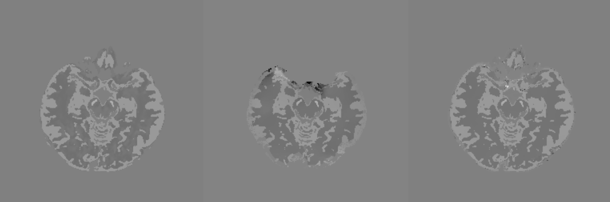
Phase uncertainty map (Fig. 4)
Ground truth | Phase uncertainty mask | Background field mask

Slide 11
Hemorrhage numerical brain
Ground truth
Control
SMV
mSMV
Ground truth
Control
SMV
mSMV

Slide 12
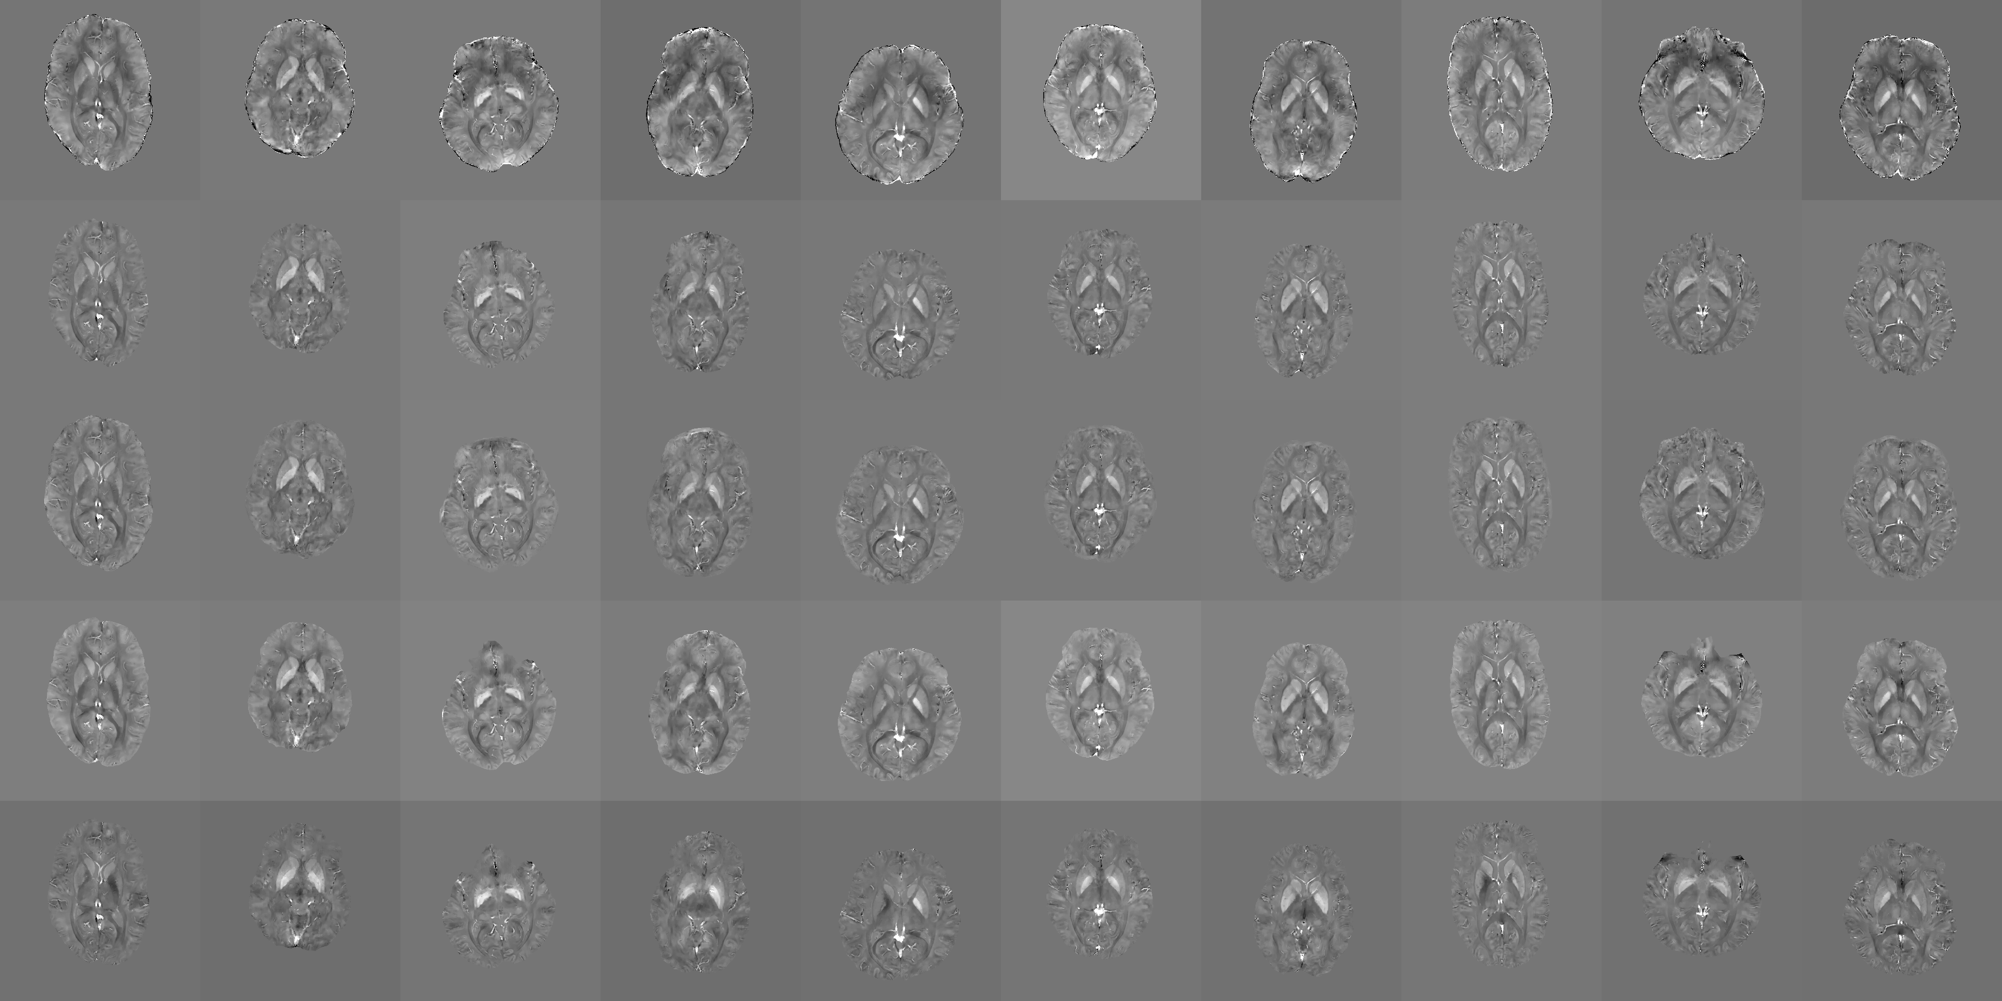
Healthy subjects

Slide 13
Hemorrhage subjects
Control
SMV
mSMV

Slide 14
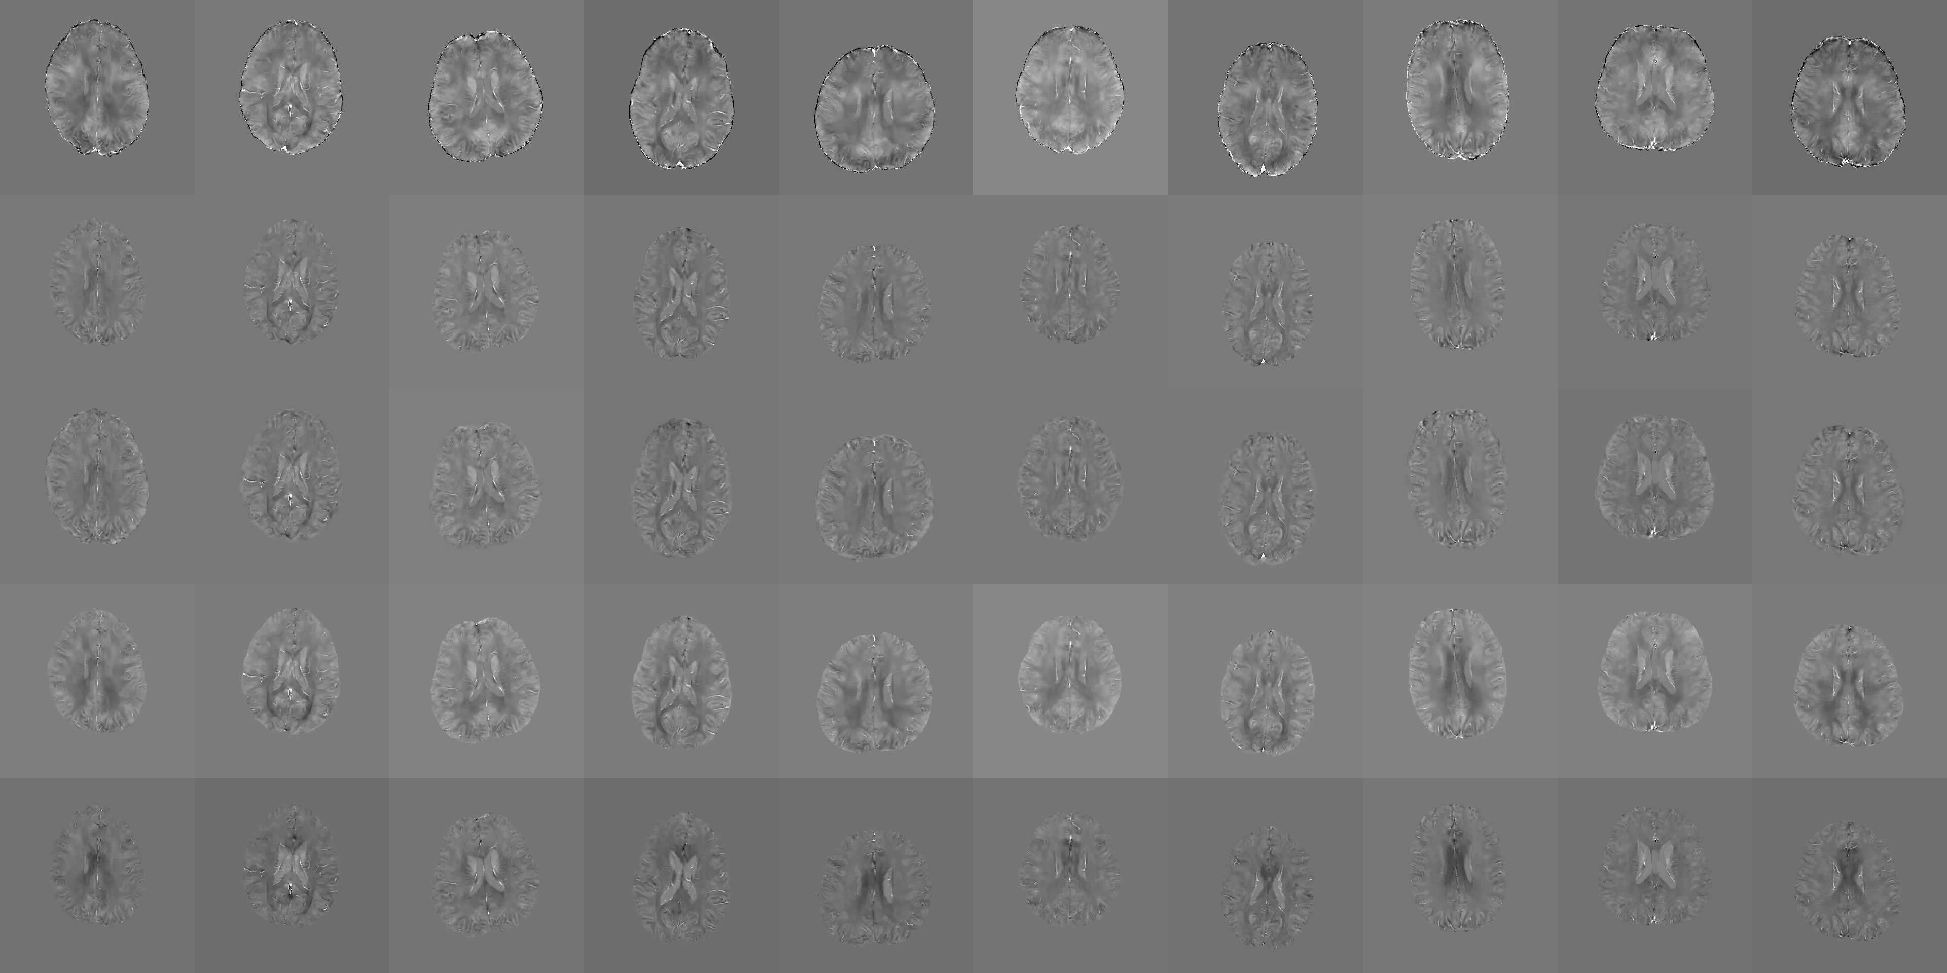
Healthy subjects

Slide 15
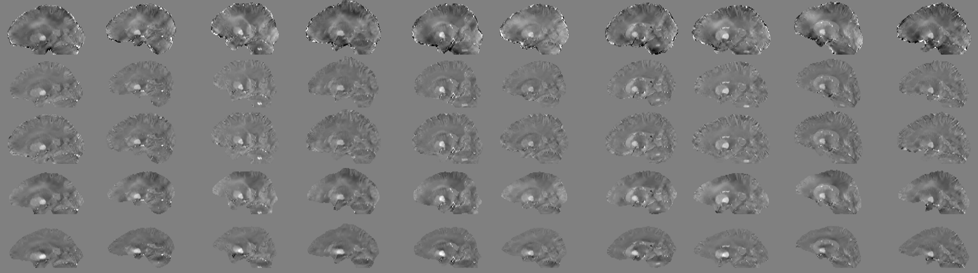
Healthy subjects

Slide 16
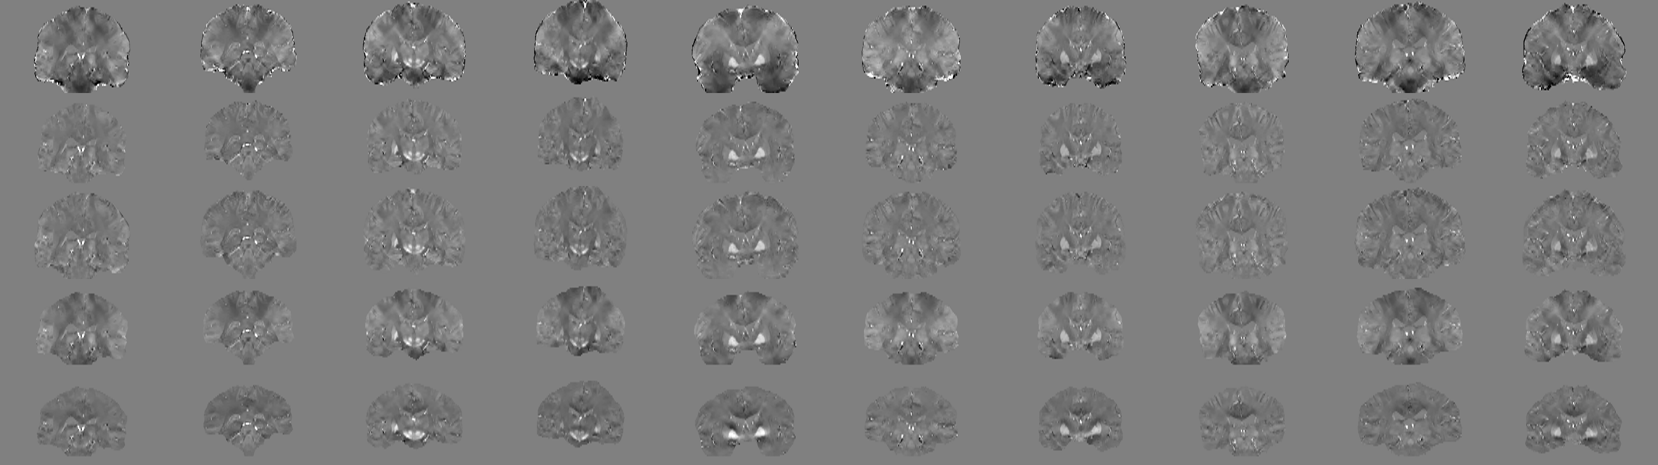
Healthy subjects

Slide 17
Healthy subject 5 (old)
Control
mSMV
LBV
VSHARP

Slide 18
Healthy subject 10 (old)
Control
mSMV
LBV
VSHARP

Slide 19
Healthy subjects combined (Fig. 5)
Control
mSMV
SMV
LBV
VSHARP
PDF

Slide 20
Healthy subjects
mSMV
mPDF
SMV
VSHARP
PDF
LBV

Slide 21
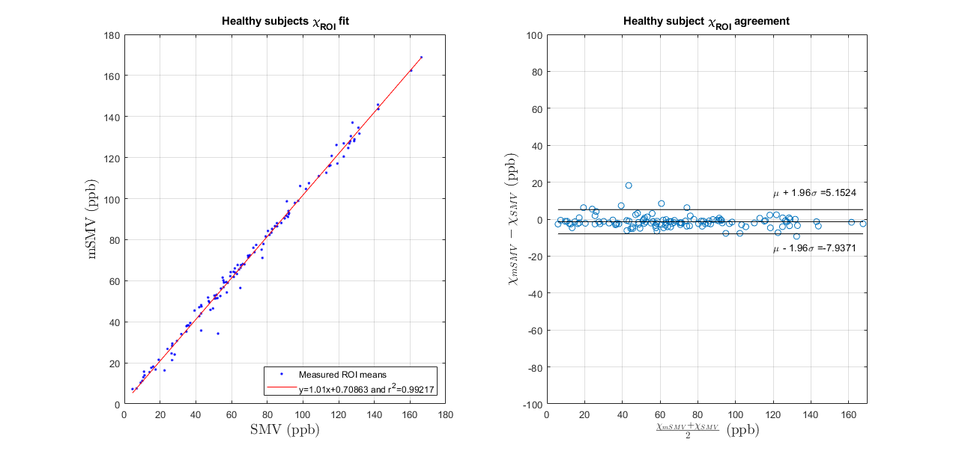
Healthy subjects SMV comparison (Fig. 6)

Slide 22
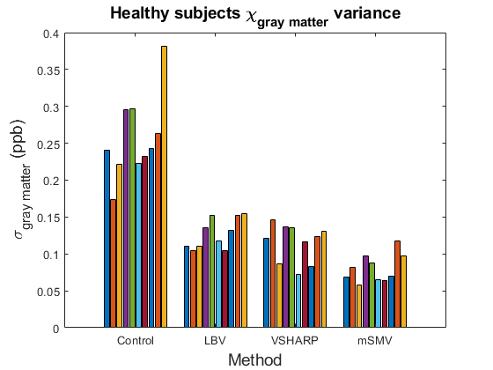
Healthy subjects shadow score

Slide 23
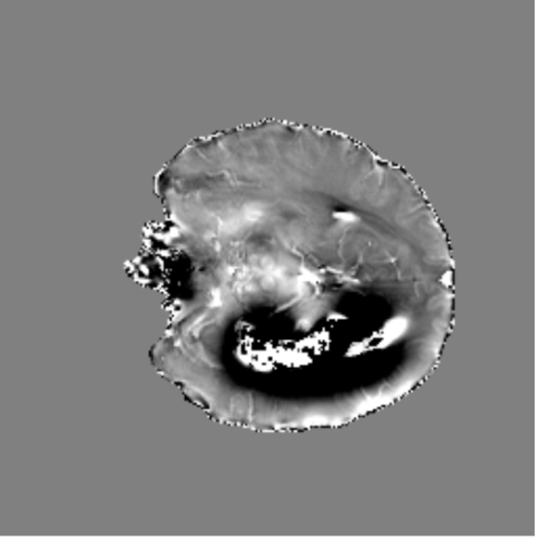
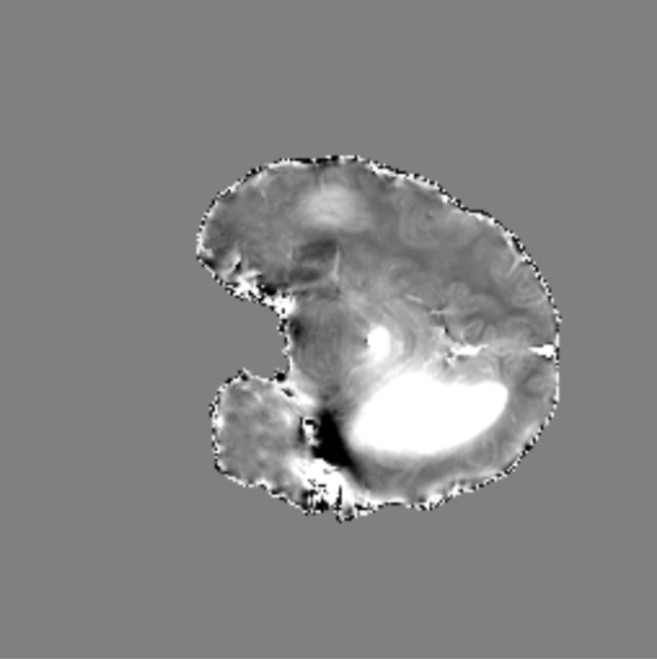
Hemorrhage case

Slide 24
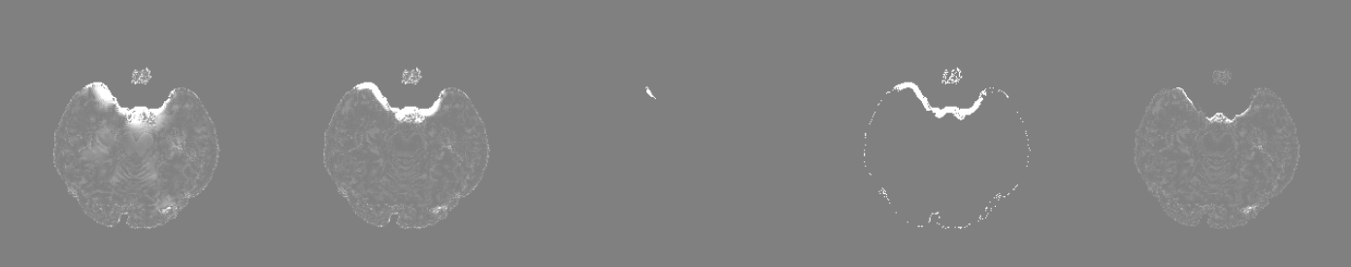
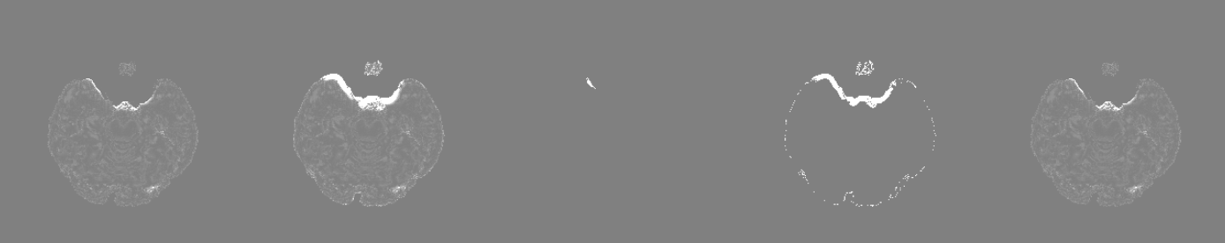
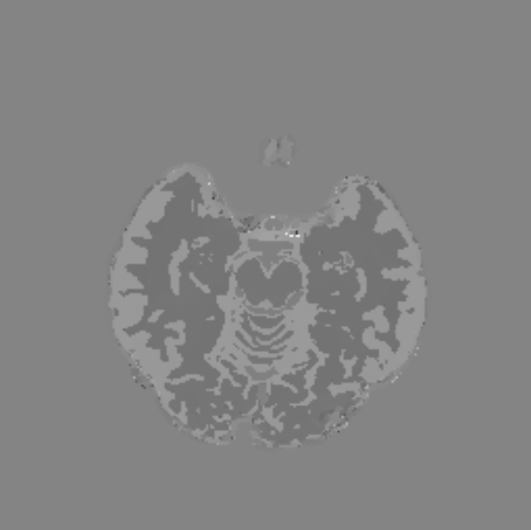




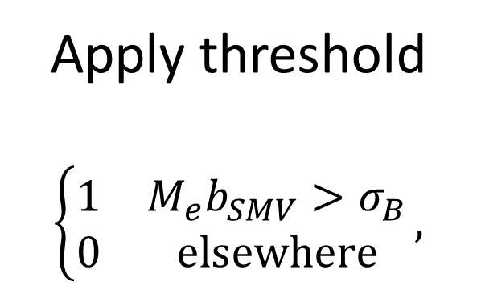
$$b_{maximum}$$
$$\text{\sim }\text{𝒩}\text{(}μ_{B},σ_{B}^{2})$$
$$M_{b_{B}}$$
Region grow
Apply threshold
$$\left\{\begin{matrix}1 & M_{e}b_{SMV}>σ_{B} \\ 0 & elsewhere\end{matrix}\right.,$$
Fit distribution
a)
b)
c)
$$b_{SMV}=b_{L}−S_{r=5}b_{L}$$
$$b_{mSMV}=b_{SMV}−{M_{b_{B}}b}_{SMV}$$
$$χ_{mSMV}$$
Remove residual background field
MEDI-L1
d)
e)
f)

Slide 25
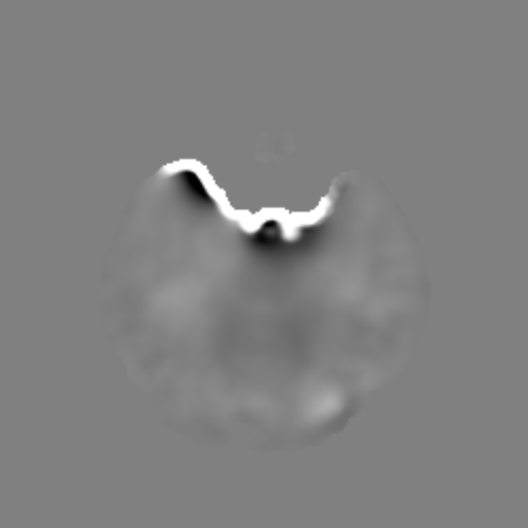
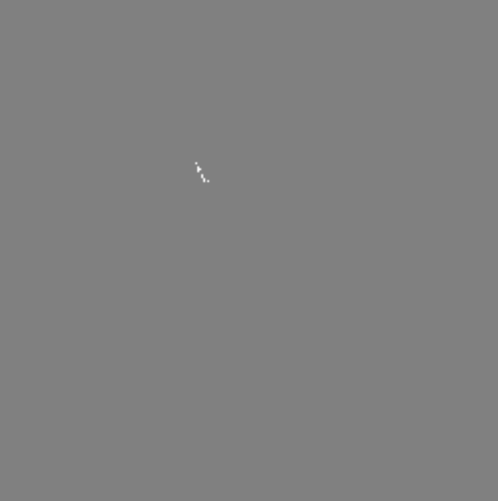
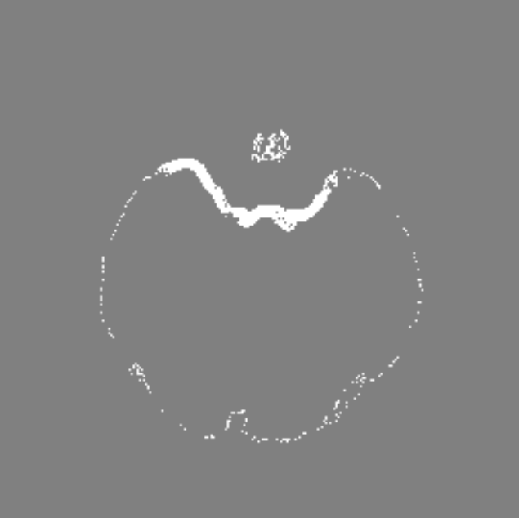
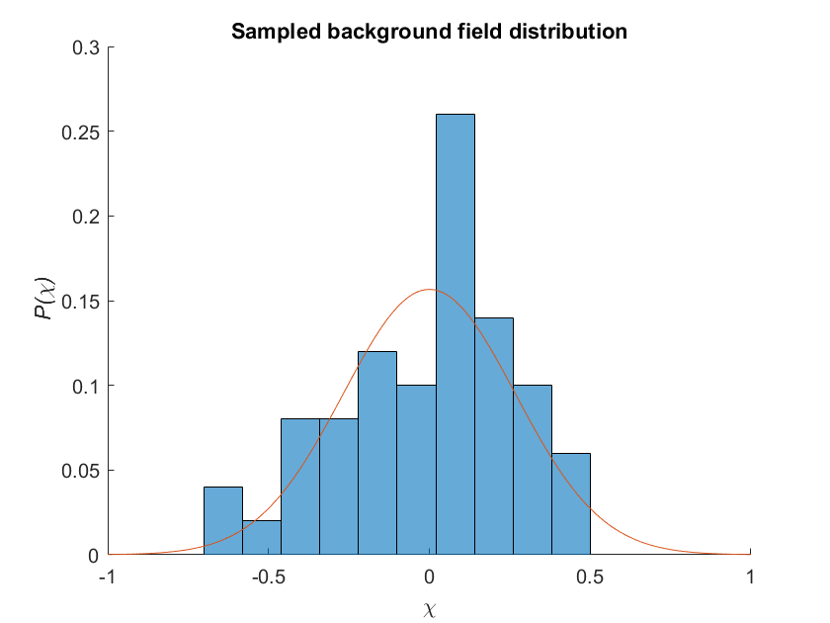

$${|b−b_{SMV}|}_{maximum}$$
$$\text{\sim }\text{𝒩}\text{(}μ_{B},σ_{B}^{2})$$
$$M_{b_{B}}$$
Region grow
Apply threshold
$$\left\{\begin{matrix}1 & M_{e}b_{SMV}>σ_{B} \\ 0 & elsewhere\end{matrix}\right.,$$
Fit distribution
a)
b)
c)
$$b_{SMV}=b_{L}−S_{r=5}b_{L}$$
$$b_{mSMV}=b_{SMV}−{M_{b_{B}}b}_{SMV}$$
$$χ_{mSMV}$$
Remove residual background field
MEDI-L1
d)
e)
f)

Slide 26
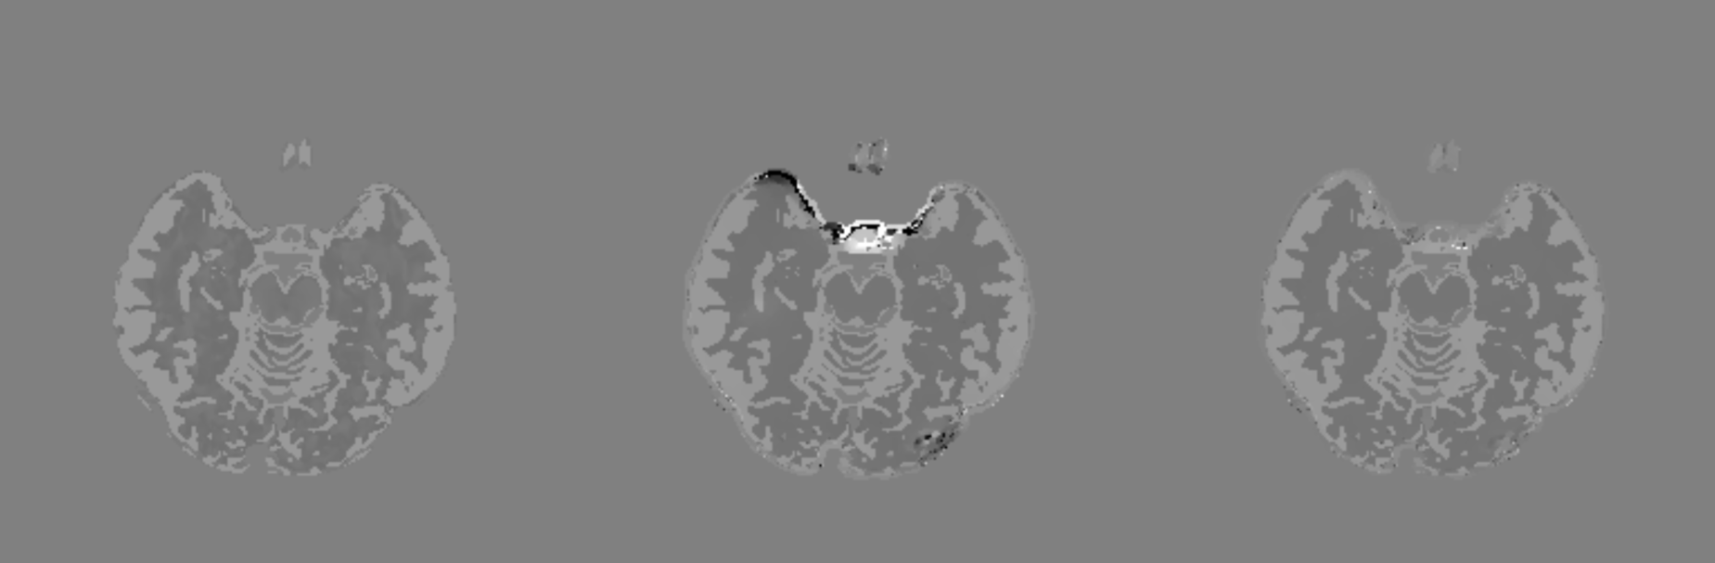
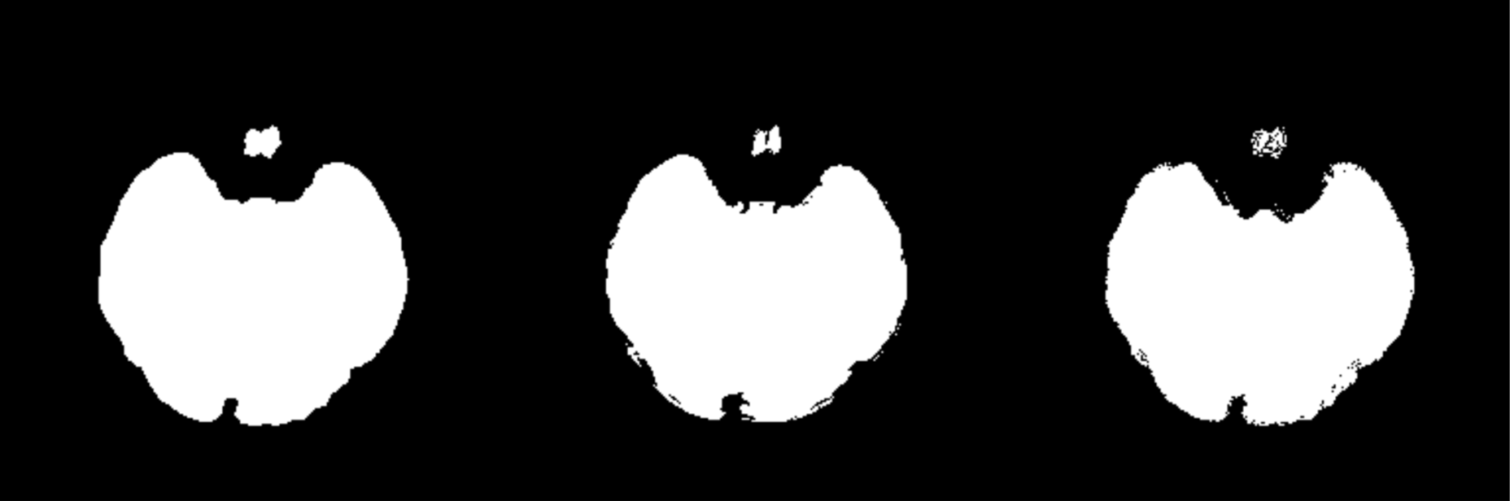
Robust mask experiment
Ground Truth | Robust Mask | mSMV Background Mask

Slide 27

Magic function
Assume the sampled residual background field is normally distributed
$$J(b−b_{SMV})\sim 𝒩(μ_{B},σ_{B}^{2})$$
Mean shift
$$J(b−b_{SMV})\sim 𝒩(0,σ_{B}^{2})$$
Call region-growing parameter $η$ and generate global threshold
$$ρ=\min{(ησ_{B},(1−ησ_{B})})$$
Apply threshold
$$M_{b_{B}}=\left\{\begin{matrix}1 & M_{e}b_{SMV}>ρ \\ 0 & else\end{matrix}\right.$$

Slide 28
Magic function implementation
function msmv(in_file,out_file)
% Load local field
load(in_file)
% Initial region-growing parameter
rg_param = 0.1;
% Generate kernel
SphereK = single(sphere_kernel(matrix_size, voxel_size,5));
% Partition mask
Mask_ne = SMV(Mask,SphereK) > 0.999;
Mask_e = Mask-Mask_ne;
% Partition field
RDF_ne = Mask_ne.*(RDF);
RDF_e = Mask_e.*(RDF);
% Find max, on edge via Green's theorem
[maxval,idxmax] = max(RDF(:));
[r,c,p] = ind2sub(size(RDF),idxmax);
% Perform initial SMV, then address incorrect values at edge
RDF_s0 = Mask.*(RDF-SMV(RDF,SphereK));
% Region grow from max seed point, output residual background field mask J
[P,J] = regionGrowing(abs(RDF_s0),[r c p],rg_param*max(RDF_s0(:)),min(matrix_size(:)).*min(voxel_size(:)));
while sum(J(:)) < (1/2)*min(matrix_size)
rg_param = 1.1*rg_param;
[P,J] = regionGrowing(abs(RDF_s0),[r c p],rg_param*max(abs(RDF_s0(:))),min(matrix_size(:)).*min(voxel_size(:)));
end
% Fit normal distribution to difference in original and filtered local field in known background field mask
RDF_bk = abs(RDF-RDF_s0).*J;
RDF_bk = abs(RDF_bk(abs(J(:))>0));
f_bk = fitdist(RDF_bk(:)-mean(RDF_bk(:)),'normal');
f_ne = fitdist(RDF_ne(:)-mean(RDF_ne(:)),'normal');
% Create global mask of residual background field
Mask_bk = imbinarize(abs(Mask_e.*RDF_s0),min(f_bk.sigma.*rg_param,(f_bk.sigma.*(1-rg_param))));
disp('Residual background field threshold in radians is:')
disp(string(min(f_bk.sigma.*rg_param,(f_bk.sigma.*(1-rg_param)))))
RDF_s = Mask.*(RDF_s0-Mask_bk.*RDF_s0);
RDF = RDF_s;
save(out_file,'B0_dir','CF','delta_TE','iFreq', 'iFreq_raw', 'iMag', 'Mask', 'Mask_CSF', 'matrix_size', 'N_std', 'RDF', 'voxel_size');
end

Slide 29
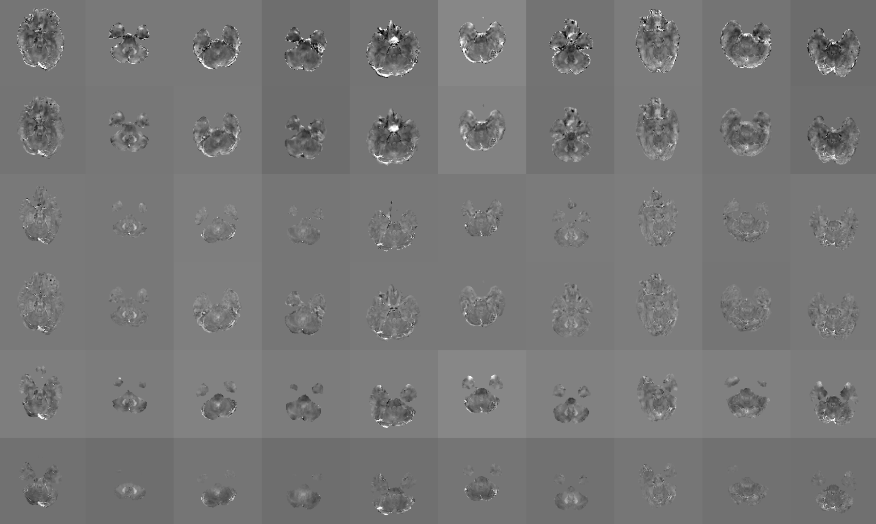
Magic function results

Slide 30
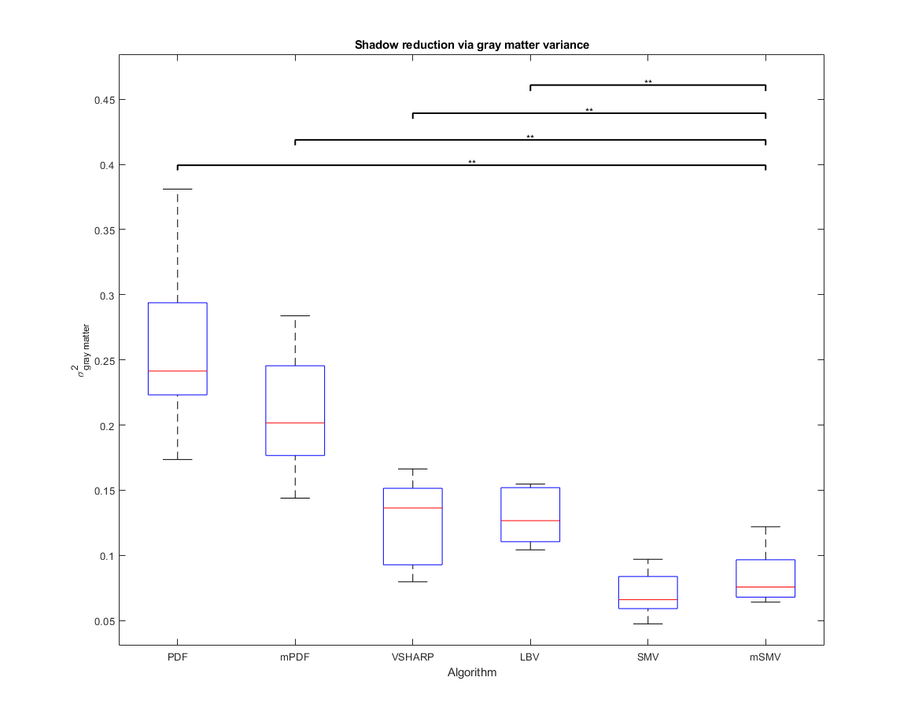
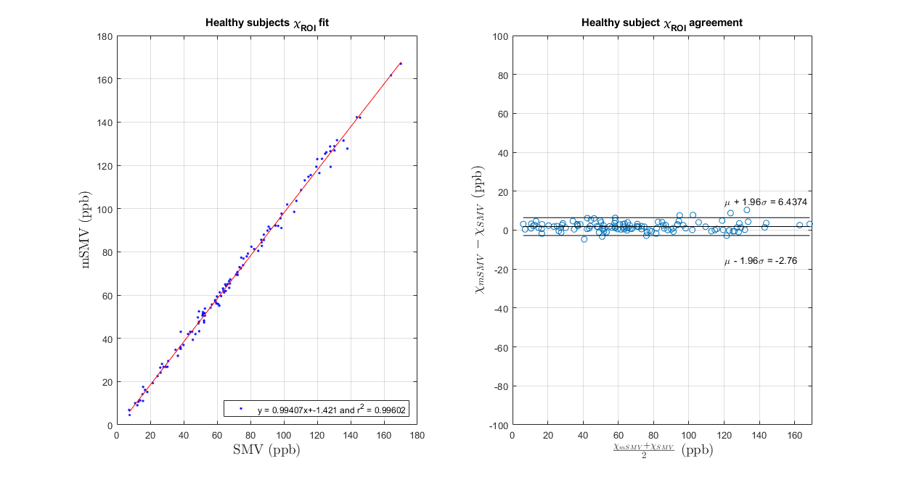
Magic function results

